Slide 1


Speakers
John Roe
Vice President Modern Tax
Tony Ogden
Director Modern Tax Platforms

Slide 2

About H&R Block
Founded in 1955 by Henry and Richard Bloch
80,000+ Tax Professionals across the US, Canada and Australia
11,000 company and franchise locations
23 million prepared tax returns
8 million online clients self-prepared

Slide 3

Tax Season Facts
“We’re not seasonal! You’re seasonal!”
Limited window for filing taxes
Peaks and valleys
One chance to make a first impression
12 days on average to file per client
Limited # of year-round offices
4-6 month delivery timeframe
High volume of Seasonal workforce

Slide 4
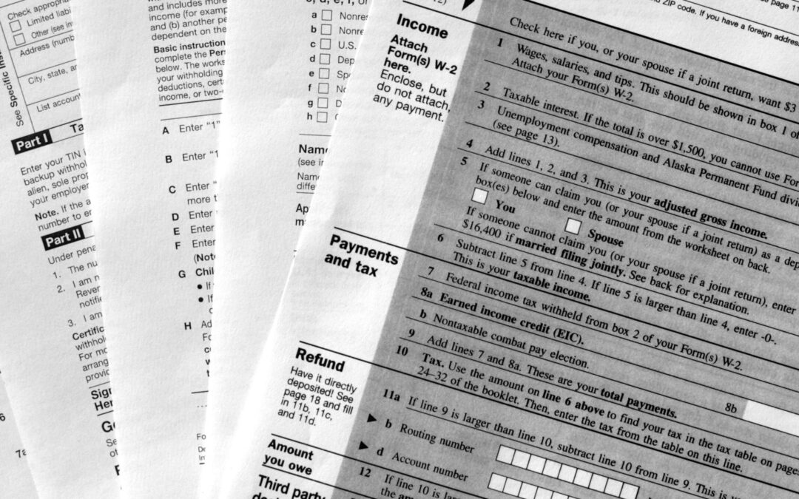
Tax Complexity
150k regulatory fields
15k tax regulatory changes each year
Fed plus 44 DOR’s
City/County taxes
Unique customer challenges

Slide 5

Tax Complexity
Tax Field Tree View

Slide 6
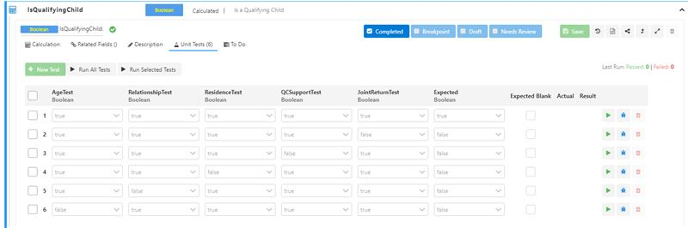
Shift Left Testing
Calculated Field Unit Test

Slide 7
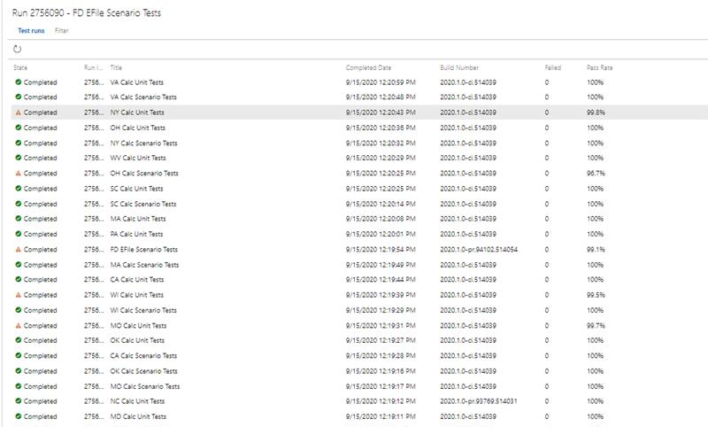
Shift Left Testing
Automated Test Execution

Slide 8
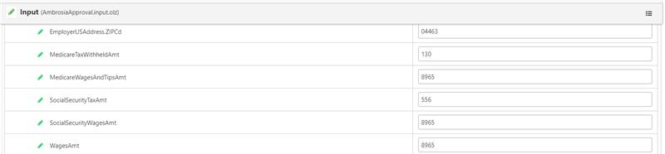
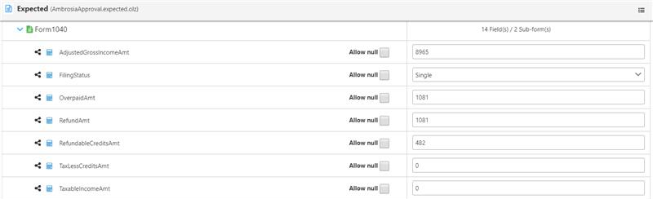
Shift Left Testing
Tax Scenario Testing

Slide 9
Migration to the Cloud
Micro-
Sites
Micro-Services
Lift & Shift
Cloud Native
Cloud Movement
Monolithic tax application Microservices & PaaS
Shift to PaaS
Office infrastructure Cloud infrastructure
Capability Driven
Reliance on manual testing Next gen testing capabilities
Siloed teams & applications Feature teams & Omni-channel
Micro-
Apps
Re-Platform

Slide 10

Enterprise DevOps
Larger Enterprise Impact
DevOps User Groups
Centers of Excellence
Director of DevOps Transformation
Organizational Design
Bottom Up/Top Down
Be Bold/Empowered Teams

